Slide 1


Slide 2
Analysis Concepts & Modeling

Slide 3
Requirement Analysis
Requirement Analysis is a software engineering task that bridges the gap between system level requirement engineering and software design
If you don’t analyze it, its highly likely that you will build a highly elegant software that solves the wrong problem

Slide 4
Operational Analysis Principles
Information domain of a problem must be represented and understood.
The functions that the software is to perform must be defined.
The behavior of the software must be represented.
The models that depict information, function, and behavior must be partitioned in a manner that uncovers detail in a layered fashion.
The analysis process should move from essential information toward implementation detail.

Slide 5
Analysis Rules of Thumb
Model should focus on requirements that are visible within the problem or business domain.
Each element of the requirements model should add to an overall understanding of software requirements and provide insight into the information domain, function and behavior of the system.
Delay consideration of infrastructure and other nonfunctional models until design
Minimize coupling throughout the system
Be certain that requirements model provides value to all stakeholders
Keep the model as simple as it can be.

Slide 6
Specification
Specification Principles
Separate functionality from implementation.
Develop a model of the desired behavior of a system.
Establish the context in which software operates.
Define the environment in which the system operates
Create a cognitive model
Recognize that “the specifications must be tolerant of incompleteness and augmentable.”
Establish the content and structure of a specification amenable to change

Slide 7
The Software Requirements Specification
The function and performance allocated to software as part of system engineering are refined by establishing
a complete information description
a detailed functional description
a representation of system behavior
an indication of performance requirements
design constraints
appropriate validation criteria
other information pertinent to requirements.

Slide 8
The Software Requirements Specification
Introduction – goals and objectives
Information description – detailed description of the problem
Functional description – description of each function
Behavioral description – operation of the software as a consequence of external events
Validation criteria – implicit review of all other requirements
Bibliography – references to all documents that relate to the software
Appendix – supplements the specifications.

Slide 9
Modeling
Scenario-based models
Data models
Class-oriented models
Flow-oriented models
Behavioral models

Slide 10
Modeling
Functional model(Flow-oriented models)
Software transforms information
To accomplish this, it must perform at least three generic functions: input, processing, and output.
When created, the software engineer focuses on problem specific functions.
Behavioral model
Most software responds to events from outside world.
This response forms the basis of the behavioral model.

Slide 11
Analysis Model
Data Model
Functional
Model
Behavioral
Model

Slide 12
The Elements of the Analysis Model
Objectives
Describe what the customer requires
Establish a basis for the creation of a software design
Define a set of requirements that can be validated once the software is built.

Slide 13
Structure of the Analysis Model
Data Dictionary – repository that contains descriptions of all data objects consumed or produced by the software
Entity relation diagram – relationships between data objects
Data flow diagram –
Provide an indication of how data are transformed as they move through the system
Depict the functions (and sub functions) that transform the data flow
State transition diagram – how the system behaves as a consequence of external events.

Slide 14
Data Model
A data model is the structure in which a computer program stores persistent information. philip.greenspun.com/panda/glossary.html
A graphical (Entity Relationship Diagram or ERD) and textual (data dictionary) representation of the business data deemed of interest to an organization. It is a representation of data objects that can be shared and reused across application systems, organizational boundaries, and different functional areas. www.cio.gov.bc.ca/other/daf/IRM_Glossary.htm

Slide 15
Data Modeling
Data objects – composite information
External entity
Thing
Occurrence
Role
Organizational unit
Place
Structure

Slide 16
Entity
Anything real or abstract about which we want to store data.
Entity types fall into five classes: roles, events, locations, tangible things or concepts. E.g. employee, payment, campus, book.
Specific examples of an entity are called instances. E.g. the employee John Jones, Mary Smith's payment, etc.

Slide 17
Attributes
Define the properties of a data object
A data attribute is a characteristic common to all or most instances of a particular entity.
Synonyms include property, data element, field. E.g. Name, address, Employee Number, pay rate are all attributes of the entity employee.
An attribute or combination of attributes that uniquely identifies one and only one instance of an entity is called a primary key or identifier. E.g. Employee Number is a primary key for Employee.

Slide 18
Relationships
Is a natural association that exists between one or more entities. E.g. Employees process payments.

Slide 19
Cardinality
Cardinality defines
The number of occurrences of one entity for a single occurrence of the related entity. E.g. an employee may process many payments but might not process any payments depending on the nature of her job.
One-to-one
One-to-many
Many-to-many

Slide 20
Modality
Defines the need for the relationship to occur
Modality = 0
Modality = 1

Slide 21
ERD Notation
One common form:
(0, m)
object
relationship
object
1
(1, 1)
2
attribute
Another common form:
object
relationship
object
1
2
(0, m)
(1, 1)

Slide 22
The ERD: An Example
request
for service
Customer
places
(1,1)
(1,m)
(1,1)
standard
task table
generates
(1,n)
work
order
(1,1)
(1,1)
(1,1)
selected
from
work
tasks
(1,w)
consists
of
(1,w)
(1,i)
materials
lists

Slide 23
A Simple Example
A company has several departments. Each department has a supervisor and at least one employee. Employees must be assigned to at least one, but possibly more departments. At least one employee is assigned to a project, but an employee may be on vacation and not assigned to any projects. The important data fields are the names of the departments, projects, supervisors and employees, as well as the supervisor and employee number and a unique project number.

Slide 24
1. Identify Entities
The entities in this system are Department, Employee, Supervisor and Project.
One is tempted to make Company an entity, but it is a false entity because it has only one instance in this problem.
True entities must have more than one instance.

Slide 25
2. Find Relationships
We construct the following Entity Relationship Matrix:
 | Department | Employee | Supervisor | Project
Department |  | is assigned | run by
Employee | belongs to |  |  | works on
Supervisor | runs
Project |  | uses

Slide 26
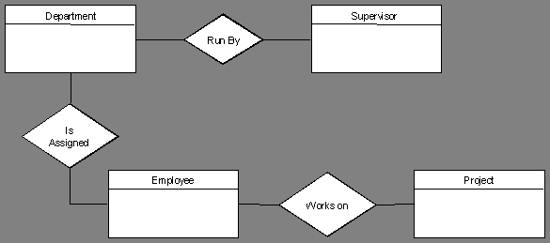
3. Draw Rough ERD
We connect the entities whenever a relationship is shown in the entity Relationship Matrix.

Slide 27
4. Fill in Cardinality
From the description of the problem we see that:
Each department has exactly one supervisor.
A supervisor is in charge of one and only one department.
Each department is assigned at least one employee.
Each employee works for at least one department.
Each project has at least one employee working on it.
An employee is assigned to 0 or more projects.

Slide 28
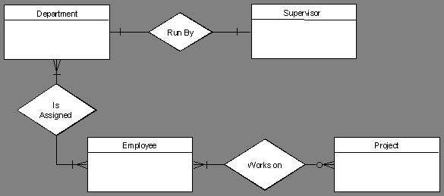

Slide 29
5. Identify Attributes
The only attributes indicated are the names of the departments, projects, supervisors and employees, as well as the supervisor and employee NUMBER and a unique project number.

Slide 30
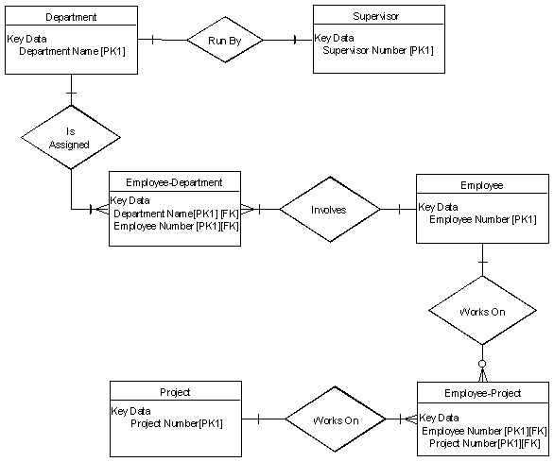

Slide 31
Functional Modeling
Every computer-based system is an
information transform ....
computer
based
system
input
output

Slide 32
Data Flow Diagram
Data flow diagramming shows business processes and the data that flows between them
Data flow diagrams illustrate how data is processed by a system in terms of inputs and outputs.
The Data Flow Diagram shows the flow of data or information.

Slide 33
Advantages of the Data Flow Diagram Approach
Advantages over narrative explanations of data movement
Understanding of the interrelationships of systems and subsystems
Communicating current system knowledge to users
Analysis of the proposed system

Slide 34
Four Basic Elements
A dataflow diagram consists of
External Entities
Processes
Data Flow
Data Stores

Slide 35
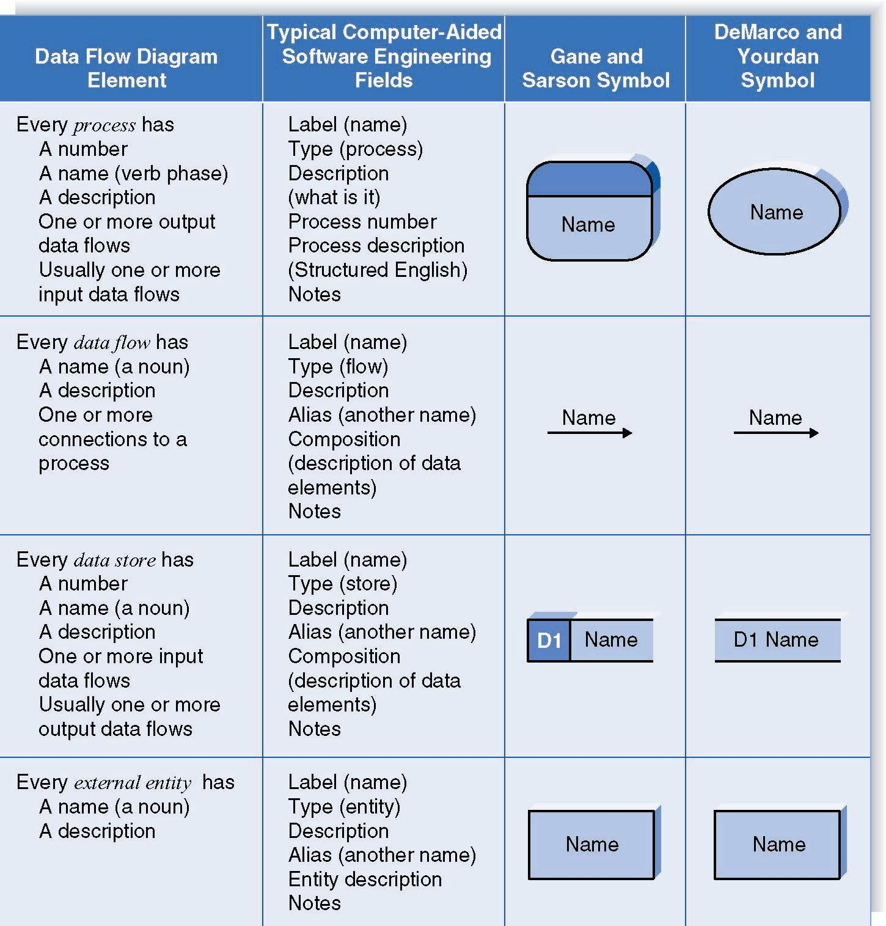
DFD Elements

Slide 36
DFD Shapes from Visio

Slide 37
External Entities
Represent people or organizations outside of the system being studied
Shows the initial source and final recipient of data and information
Should be named with a noun, describing that entity

Slide 38
External Entities
External entities may be
A person, such as CUSTOMER or STUDENT
A company or organization, such as BANK or SUPPLIER
Another department within the company, such as ORDER FULFILLMENT
Another system or subsystem, such as the INVENTORY CONTROL SYSTEM

Slide 39
Processes
Represent either:
A whole system
A subsystem
Work being done, an activity
Names should be in the form verb-adjective-noun

Slide 40
Data Stores
Name with a noun, describing the data
Data stores are usually given a unique reference number, such as D1, D2, D3
Include any data stored, such as:
A computer file or database
A transaction file
A set of tables
A manual file of records
sensor #
sensor #, type,
location, age
look-up
sensor
data
report required
type,
location, age
sensor number
sensor data

Slide 41
Data Flow
Shows the data about a person, place, or thing that moves through the system
Names should be a noun that describes the data moving through the system
Arrowhead indicates the flow direction
Use double headed-arrows only when a process is reading data and updating the data on the same table or file
compute
triangle
area
base
area
height

Slide 42
Developing Data Flow Diagrams
Use the following guidelines:
Create the context level diagram, including all external entities and the major data flow to or from them
Create Diagram 1 by analyzing the major activities within the context process
Include the external entities and major data stores
Create a child diagram for each complex process on Diagram 1

Slide 43
Creating Data Flow Diagrams
Detailed data flow diagrams may be developed by
Making a list of business activities
Analyzing what happens to an input data flow from an external entity
Analyzing what is necessary to create an output data flow to an external entity
Examining the data flow to or from a data store
Analyzing a well-defined process for data requirements and the nature of the information produced
Unclear areas of a data flow diagram should be noted and investigated

Slide 44
Data Flow Diagram Levels
Data flow diagrams are built in layers
The top level is the Context level
Each process may explode to a lower level
The lower level diagram number is the same as the parent process number
Processes that do not create a child diagram are called primitive

Slide 45
Context Level Data Flow Diagram
The level 0 DFD should depict the software/system as a single bubble
Contains only one process, representing the entire system
The process is given the number zero
All external entities are shown on the context diagram as well as major data flow to and from them
The diagram does not contain any data stores

Slide 46
Several Common Modeling Rules
All processes must have at least one data flow in and one data flow out.
All processes should modify the incoming data, producing new forms of outgoing data.
Each data store must be involved with at least one data flow
Each external entity must be involved with at least one data flow
A data flow must be attached to at least one process.

Slide 47
Key Definitions
Decomposition is the process of modeling the system and its components in increasing levels of detail
Balancing involves ensuring that information presented at one level of a DFD is accurately represented in the next level DFD.

Slide 48
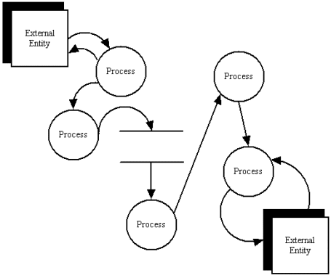
A data flow diagram

Slide 49
Library example
Consider a library item presented the user at the issue desk for borrowing, returning or reserving
‘Library world’ can be partitioned into the domains of the issue desk and the library user
Data-flow and state transition schemes are used to model the library item from point of view each domain

Slide 50
DFD – Practical Example

Slide 51
Behavioral Model
events
behavior
Outside
world
Application

Slide 52
Behavioral Modeling
make a list of the different states of a system
(How does the system behave?)
indicate how the system makes a transition from one state to another (How does the system change state?)
indicate event
indicate action
draw a state transition diagram

Slide 53
State Transition Diagram
The State Transition Diagram represents the behavior of a system by depicting its states and the events that causes the system to change state
STD indicates what actions are taken as a consequence of a particular event
It indicates how the system moves from state to state

Slide 54
The States of a System
State — a set of observable circum-stances that characterizes the behavior of a system at a given time
State Transition — the movement from one state to another
Event — an occurrence that causes the system to exhibit some predictable form of behavior
Action — process that occurs as a consequence of making a transition

Slide 55
State Transition Diagram Notation
state
event causing transition
action that occurs
new state

Slide 56
State Transition Diagram for Microwave

Slide 57
Sequence of Actions
Select the power level
Input the cooking time
Press the start and the food is cooked for the given time

Slide 58
State
Waiting
Half power
Full power
Set time
Disabled
Enabled
Operation
Description
Oven is waiting for input
Power is set to 300 watts
Power is set to 600
Time acc. To user input
Display shows ‘not ready’
Display shows ‘ready’
Oven in operation

Slide 59
State Transition Diagram
full and start
invoke manage-copying
reading
operator
commands
full
copies done
invoke read-op-input
invoke read-op-input
making copies
reloading paper
empty
invoke reload paper
jammed
invoke problem-diagnosis
not jammed
problem state
invoke read-op-input

Slide 60
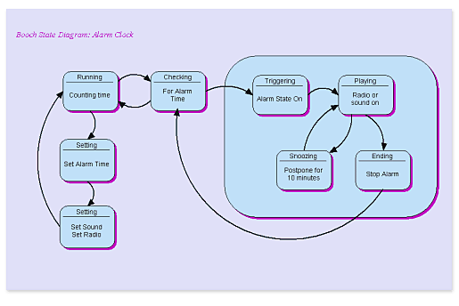
Example

Slide 61
References:
Software Engineering - A practitioner’ s Approach by Roger S. Pressman (7th Edition)

